Slide 1
FLIGHT PRICE PREDICTION
Bishwajit Bhattacharya

Slide 2
Visualization
Since there is different types of data type for proper visualization we need to encode data types first.
df['Airline Name']=lencode.fit_transform(df['Airline Name'])
df['Source']=lencode.fit_transform(df['Source'])
df['Destination']=lencode.fit_transform(df['Destination'])
df['Duration']=lencode.fit_transform(df['Duration'])
df['Dept Time']=lencode.fit_transform(df['Dept Time'])

Slide 3
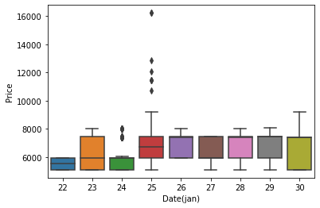
Date Vs Price

Slide 4
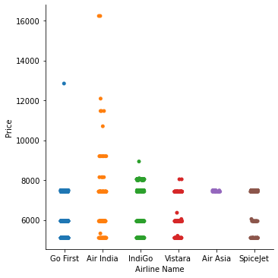
Airline Name vs Price

Slide 5
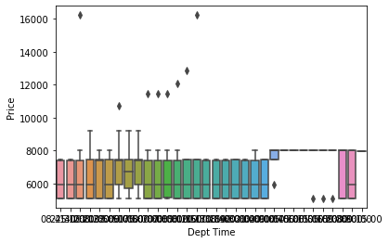
Departure Time vs Price

Slide 6
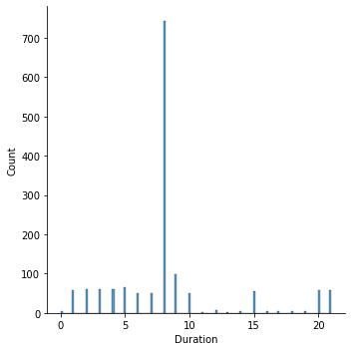
Duration Plot

Slide 7
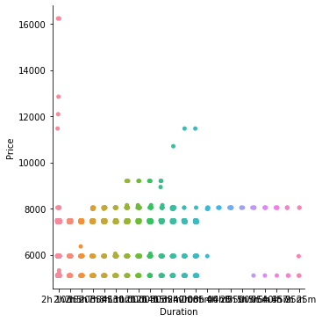
Duration vs Price

Slide 8
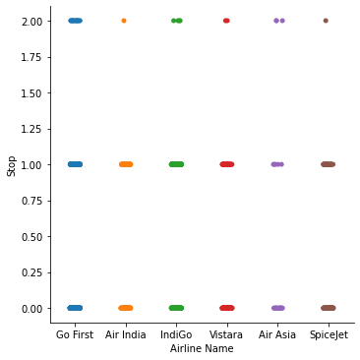
Airline name vs Stop

Slide 9
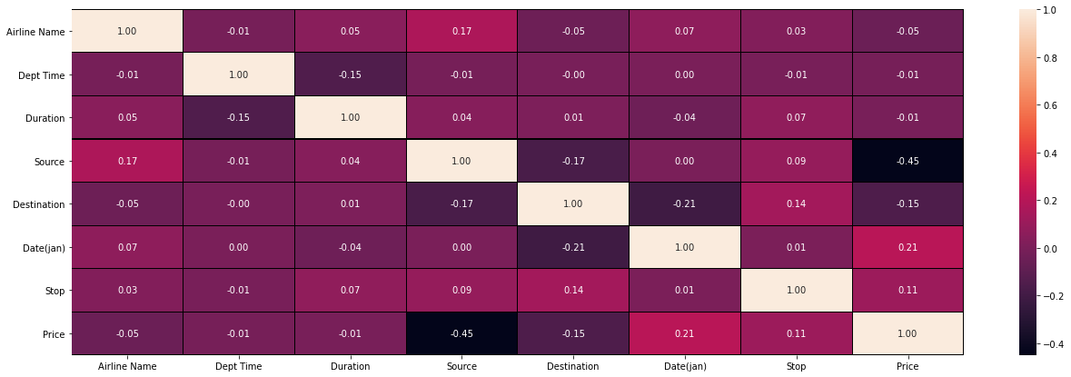
Heat Map

Slide 10
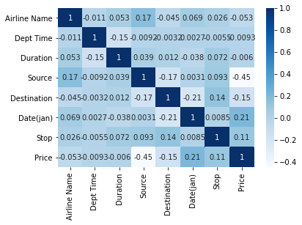
Heat Map on correlation

Slide 11
Conclusion
All though model only give 62% but bye considering this delaying of flight the result is quite good.
We can get better result if remove this stops.
Also for getting emergency time flight price I done some assumption which is also effect results.
So this model can get better output on different date. Where this delay time will not present.

Slide 12
Thank You
Bishwajit Bhattacharya

